Slide 1
Genetic Algorithms:
A Tutorial
“Genetic Algorithms are good at taking large, potentially huge search spaces and navigating them, looking for optimal combinations of things, solutions you might not otherwise find in a lifetime.”
- Salvatore Mangano
Computer Design, May 1995

Slide 2
The Genetic Algorithm
Directed search algorithms based on the mechanics of biological evolution
Developed by John Holland, University of Michigan (1970’s)
  To understand the adaptive processes of natural systems
  To design artificial systems software that retains the robustness of natural systems

Slide 3
The Genetic Algorithm (cont.)
Provide efficient, effective techniques for optimization and machine learning applications
Widely-used today in business, scientific and engineering circles

Slide 4
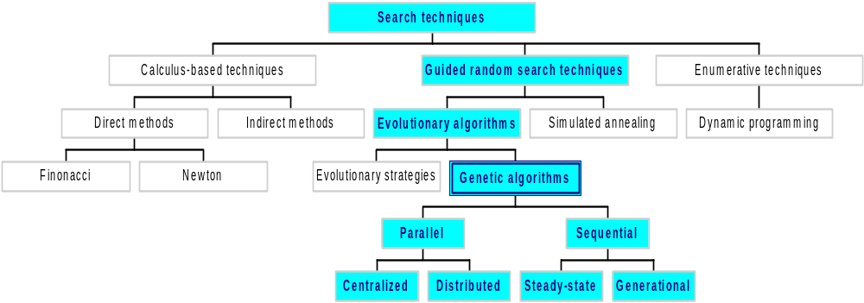
Classes of Search Techniques

Slide 5
Components of a GA
A problem to solve, and ...
Encoding technique (gene, chromosome)
Initialization procedure (creation)
Evaluation function (environment)
Selection of parents (reproduction)
Genetic operators (mutation, recombination)
Parameter settings (practice and art)

Slide 6
Simple Genetic Algorithm
{
  initialize population;
  evaluate population;
  while TerminationCriteriaNotSatisfied
  {
    select parents for reproduction;
    perform recombination and mutation;
    evaluate population;
  }
}

Slide 7
The GA Cycle of Reproduction
children
reproduction
modification
modified
children
parents
population
evaluation
evaluated children
deleted
members
discard

Slide 8
Population
population
Chromosomes could be:
  Bit strings (0101 ... 1100)
  Real numbers (43.2 -33.1 ... 0.0 89.2)
  Permutations of element (E11 E3 E7 ... E1 E15)
  Lists of rules (R1 R2 R3 ... R22 R23)
  Program elements (genetic programming)
  ... any data structure ...

Slide 9
Reproduction
children
reproduction
parents
population
Parents are selected at random with selection chances biased in relation to chromosome evaluations.

Slide 10
Chromosome Modification
Modifications are stochastically triggered
Operator types are:
  Mutation
  Crossover (recombination)
children
modification
modified children

Slide 11
Mutation: Local Modification
Before: (1 0 1 1 0 1 1 0)
After: (0 1 1 0 0 1 1 0)
Before: (1.38 -69.4 326.44 0.1)
After: (1.38 -67.5 326.44 0.1)
Causes movement in the search space
(local or global)
Restores lost information to the population

Slide 12
Crossover: Recombination
*
P1 (0 1 1 0 1 0 0 0) (0 1 0 0 1 0 0 0) C1
P2 (1 1 0 1 1 0 1 0) (1 1 1 1 1 0 1 0) C2
Crossover is a critical feature of genetic
algorithms:
  It greatly accelerates search early in evolution of a population
  It leads to effective combination of schemata (subsolutions on different chromosomes)

Slide 13
Evaluation
The evaluator decodes a chromosome and assigns it a fitness measure
The evaluator is the only link between a classical GA and the problem it is solving
modified
children
evaluated
children
evaluation

Slide 14
Deletion
population
Generational GA:
entire populations replaced with each iteration
Steady-state GA:
a few members replaced each generation
discarded members
discard

Slide 15
An Abstract Example
Distribution of Individuals in Generation 0
Distribution of Individuals in Generation N

Slide 16
A Simple Example
“The Gene is by far the most sophisticated program around.”
- Bill Gates, Business Week, June 27, 1994

Slide 17
A Simple Example
The Traveling Salesman Problem:
Find a tour of a given set of cities so that
  each city is visited only once
  the total distance traveled is minimized

Slide 18
Representation
Representation is an ordered list of city
numbers known as an order-based GA.
1) London 3) Dunedin 5) Beijing 7) Tokyo
2) Venice 4) Singapore 6) Phoenix 8) Victoria
CityList1 (3 5 7 2 1 6 4 8)
CityList2 (2 5 7 6 8 1 3 4)

Slide 19
Crossover
Crossover combines inversion and
recombination:
* *
Parent1 (3 5 7 2 1 6 4 8)
Parent2 (2 5 7 6 8 1 3 4)
Child (5 8 7 2 1 6 3 4)
This operator is called the Order1 crossover.

Slide 20
Mutation
Mutation involves reordering of the list:
* *
Before: (5 8 7 2 1 6 3 4)
After: (5 8 6 2 1 7 3 4)

Slide 21
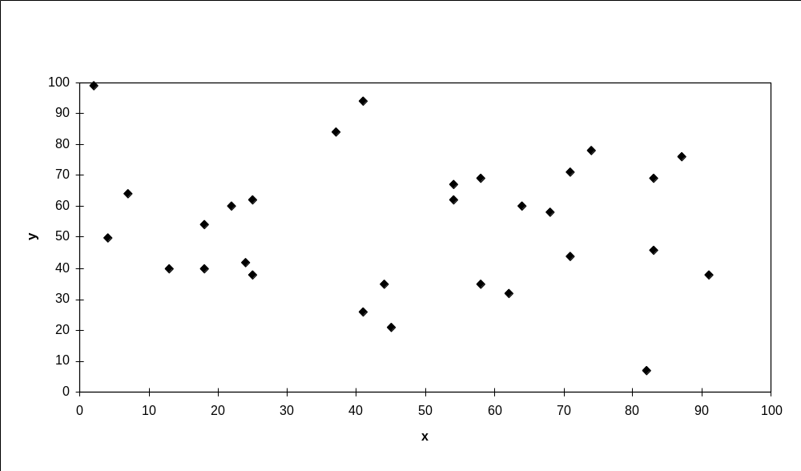
TSP Example: 30 Cities

Slide 22
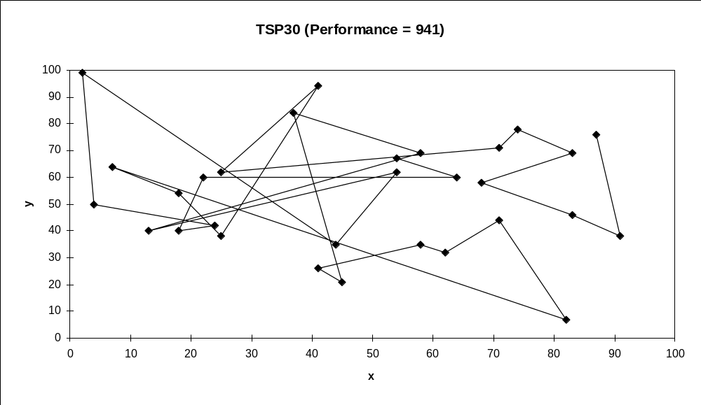
Solution _{i} (Distance = 941)

Slide 23
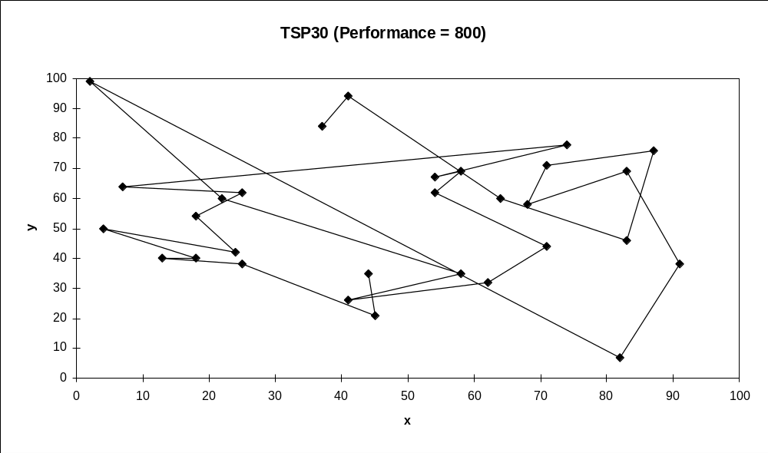
Solution _{j}(Distance = 800)

Slide 24
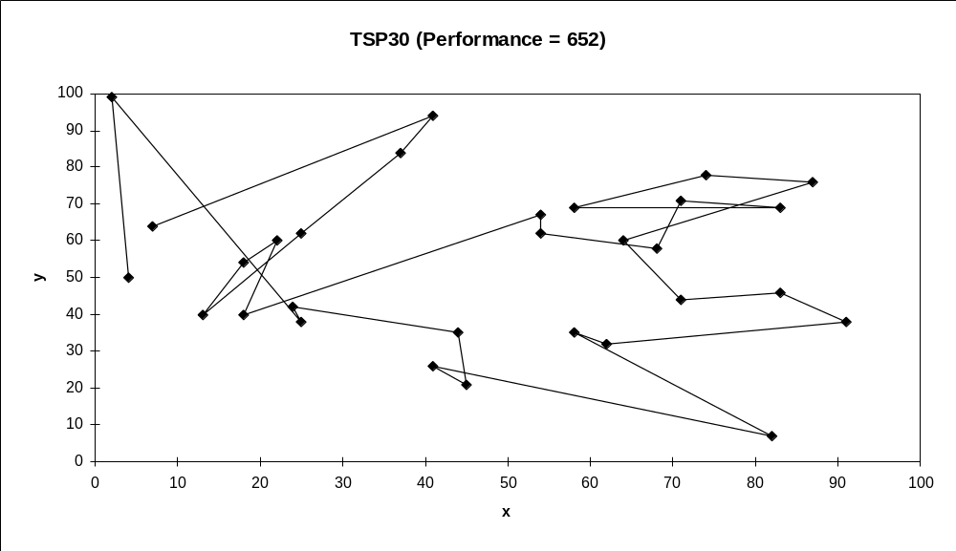
Solution _{k}(Distance = 652)

Slide 25
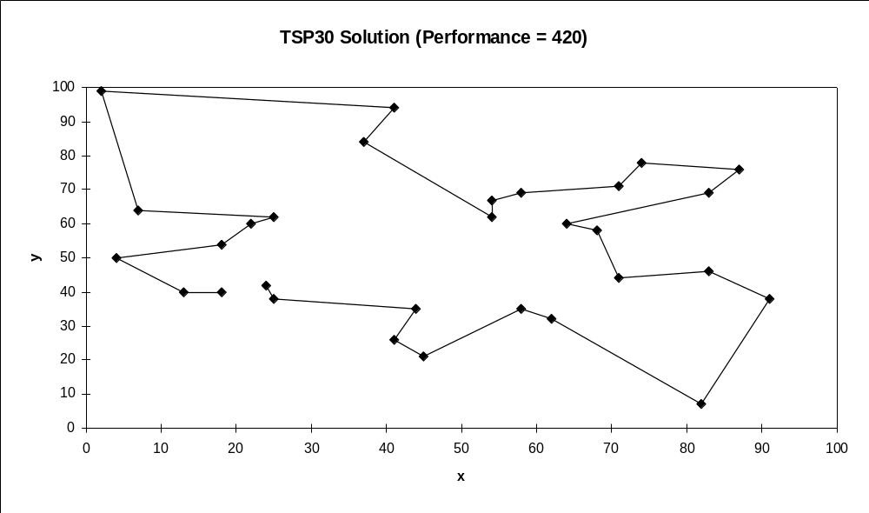
Best Solution (Distance = 420)

Slide 26
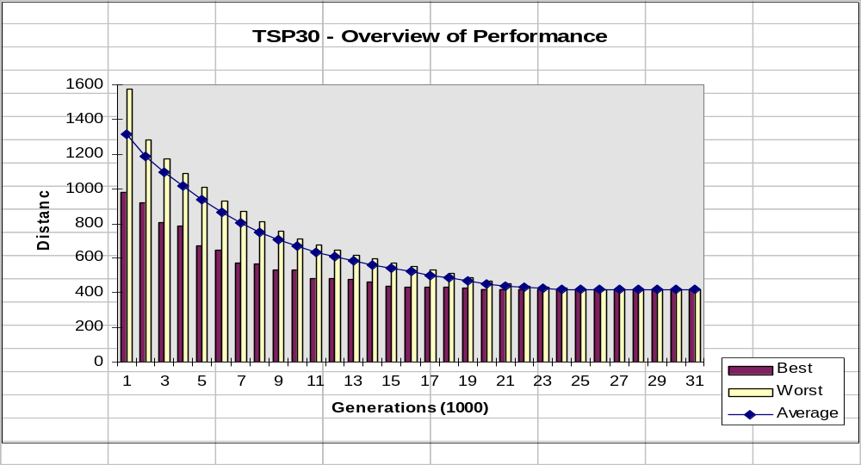
Overview of Performance

Slide 27
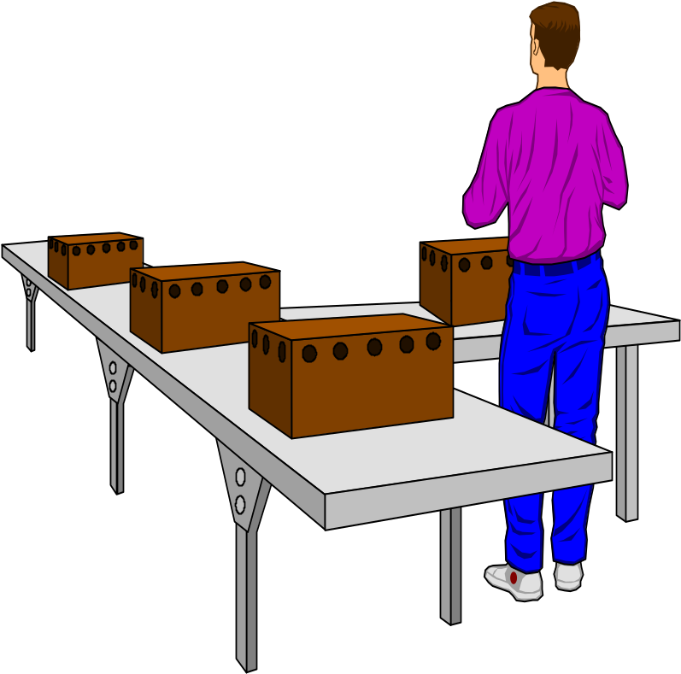
Considering the GA Technology
“Almost eight years ago ... people at Microsoft wrote a program [that] uses some genetic things for finding short code sequences. Windows 2.0 and 3.2, NT, and almost all Microsoft applications products have shipped with pieces of code created by that system.”
- Nathan Myhrvold, Microsoft Advanced Technology Group, Wired, September 1995

Slide 28
Issues for GA Practitioners
Choosing basic implementation issues:
  representation
  population size, mutation rate, ...
  selection, deletion policies
  crossover, mutation operators
Termination Criteria
Performance, scalability
Solution is only as good as the evaluation function (often hardest part)

Slide 29
Benefits of Genetic Algorithms
Concept is easy to understand
Modular, separate from application
Supports multi-objective optimization
Good for “noisy” environments
Always an answer; answer gets better with time
Inherently parallel; easily distributed

Slide 30
Benefits of Genetic Algorithms (cont.)
Many ways to speed up and improve a GA-based application as knowledge about problem domain is gained
Easy to exploit previous or alternate solutions
Flexible building blocks for hybrid applications
Substantial history and range of use

Slide 31
When to Use a GA
Alternate solutions are too slow or overly complicated
Need an exploratory tool to examine new approaches
Problem is similar to one that has already been successfully solved by using a GA
Want to hybridize with an existing solution
Benefits of the GA technology meet key problem requirements

Slide 32
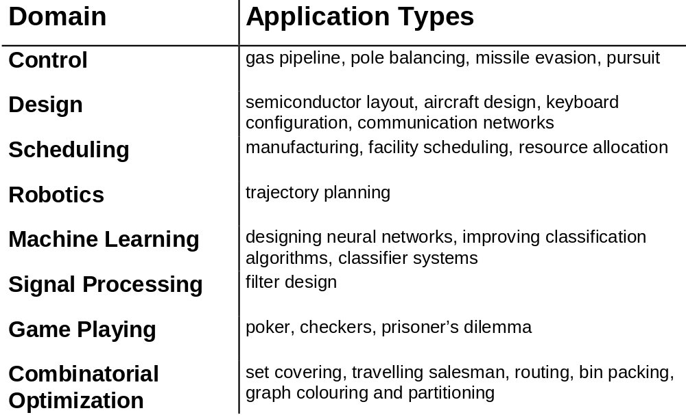
Some GA Application Types

Slide 33
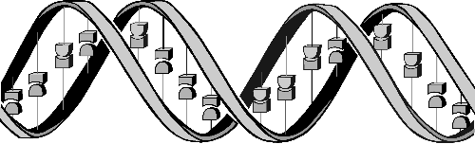
Conclusions
Question: ‘If GAs are so smart, why ain’t they rich?’
Answer: ‘Genetic algorithms are rich - rich in application across a large and growing number of disciplines.’
- David E. Goldberg, Genetic Algorithms in Search, Optimization and Machine Learning

